Slide 1


INTERN APPLICATION
PRESENTED BY GUIDED BY
VINITHA P SIVARAM SHABARI A
LOGESHWARAN S AISHWARYA
KALAIMAGAL V P DEEPTI T S
MOHAN N SUGANTHI K
VENKATESAN C TARUN

Slide 2

INTRODUCTION
Our internship management application simplifies the process of organizing and coordinating internships. It empowers organizers to efficiently schedule sessions and tasks while allowing interns to provide valuable feedback. With user-friendly features and seamless communication, our platform ensures a smooth internship experience for both organizers and interns, leading to enhanced productivity and satisfaction.

Slide 3

PROBLEM STATEMENT
Inefficient Internship Management: Existing methods lack an efficient way for organizers to communicate tasks and sessions to interns, leading to confusion and delays.
Manual Intern Profile Management: The absence of a centralized system for managing intern profiles results in time-consuming and error-prone processes for organizers.
Lack of Data-Driven Insights: Organizers struggle to gain insights into intern performance and feedback trends due to the absence of data analytics tools, limiting program improvement opportunities.

Slide 4

SOLUTION
Unified Internship Platform: Develop a web-based application that serves as a centralized platform for organizers and interns. Organizers can easily create and post tasks, sessions, and announcements, while interns can access these resources in one place.
Automated Intern Profile Management: Implement a user-friendly interface for organizers to manage intern profiles. Allow them to create, update, and delete intern profiles, including details such as personal information, skills, and progress, all within the application.
Data Analytics Dashboard: Integrate a data analytics dashboard that provides organizers with real-time insights into intern performance and feedback. Use data visualization techniques to display key metrics, such as task completion rates, feedback sentiment analysis, and attendance records. This will empower organizers to make informed decisions and optimize the internship program.

Slide 5

TOOLS AND TECHNOLOGIES USED
Class diagram (draw.io)
UI/UX Design (Figma)
Database
(MSSQL SERVER)
Backend (Java Spring boot)
Frontend (React.js)

Slide 6
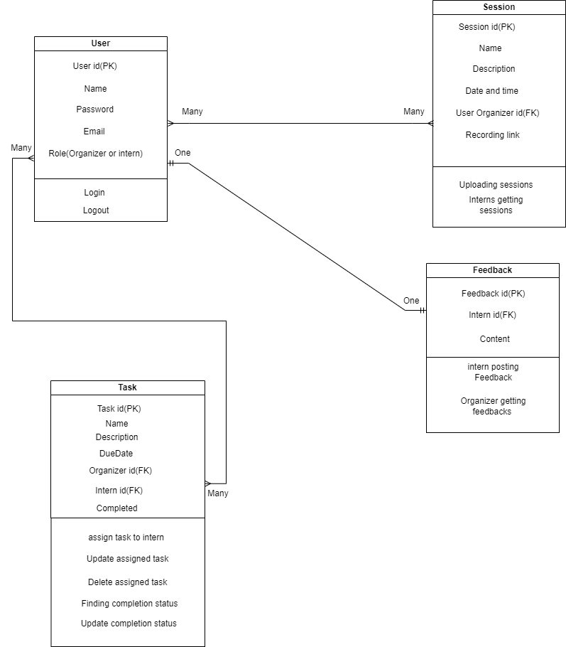
CLASS DIAGRAM
Entities:
User
Session
Task
Feedback

Slide 7
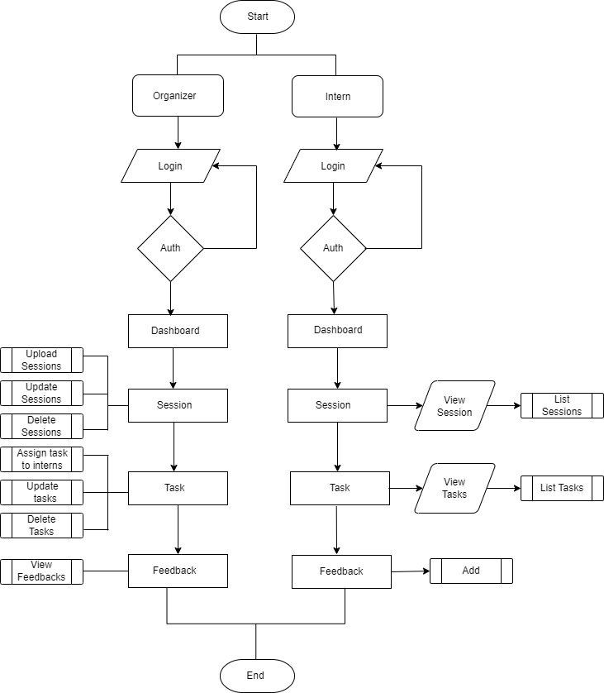

WORKFLOW

Slide 8

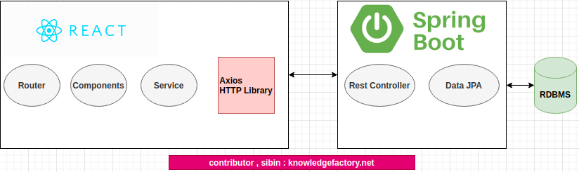
ARCHITECTURE

Slide 9
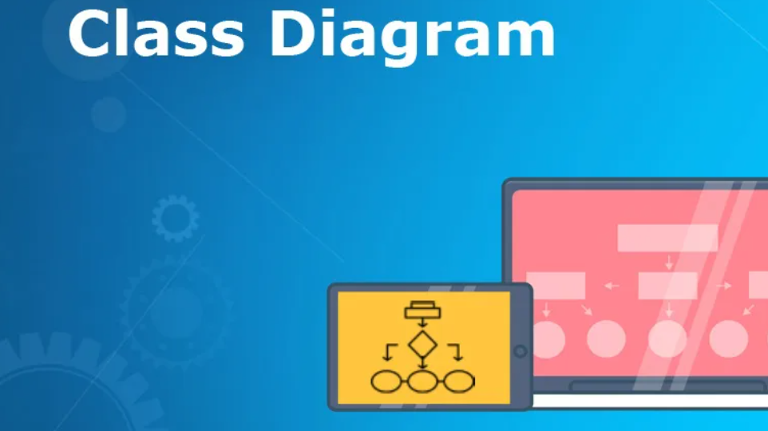
CLASS DIAGRAM(DRAW.IO)
Diagramming Tool: draw.io is a diagramming tool used for creating various types of diagrams, such as flowcharts, network diagrams, and UML diagrams.
Customization: Users can customize shapes, colors, and styles to create visually appealing diagrams tailored to their needs.
Collaboration: draw.io offers collaboration features that enable multiple users to work on the same diagram simultaneously, making it suitable for team projects.

Slide 10
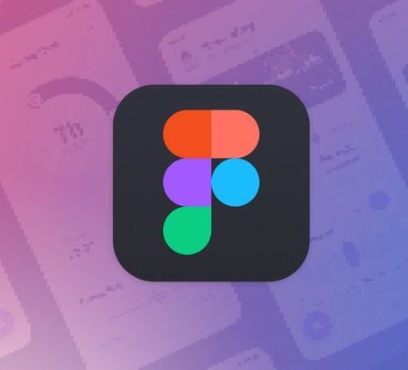
UI/UX DESIGN(FIGMA)
UI/UX Design: Figma is a cloud-based design tool primarily used for creating user interfaces (UI) and user experience (UX) designs for websites and applications.
Real-Time Collaboration: Figma excels in real-time collaboration, allowing design teams to work together on design projects concurrently from different locations.
Prototyping and Testing: Designers can create interactive prototypes in Figma to test user flows and interactions, making it a valuable tool for UI/UX design and usability testing.

Slide 11

DATABASE(MS SQL SERVER)
Database Schema: Design an efficient database schema that includes tables for users, tasks, sessions, profiles, and feedback. Define appropriate relationships and constraints.
Data Storage: Store user account details, task/session information, intern profiles, and feedback securely in the MS SQL Server database.

Slide 12

BACK-END(SPRINGBOOT)
User Authentication: Implement user authentication and authorization using Spring Security. Allow organizers and interns to register, log in, and access their respective profiles.
API Endpoints: Create RESTful API endpoints using Spring Boot to support various functionalities, including creating and managing tasks, sessions, profiles, and feedback.
Database Integration: Use Spring Data JPA to interact with the MS SQL Server database. Define entities for users, tasks, sessions, profiles, and feedback, and establish relationships between them.
Feedback System: Develop a feedback system that allows interns to submit feedback for the entire internship experience. Store feedback data in the database for analysis.

Slide 13

FRONT-END(REACTJS)
User Interface: Build an intuitive and responsive user interface using ReactJS. Design separate views for organizers and interns, focusing on ease of use.
Task and Session Management: Create forms and views for organizers to add, update, and delete tasks and sessions. Display these resources for interns to access.
Profile Management: Implement profile management functionality, including creating, editing, and deleting intern profiles. Organizers should have the authority to perform these actions.
Feedback Submission: Develop a user-friendly feedback submission form for interns to provide feedback on their internship experience.

Slide 14

UI DESIGN
Link:https://www.figma.com/proto/XN4NnSIeYOx8qYvVYbHDTy/Intern_App?type=design&t=ywNACPitra1JiKjj-0&scaling=scale-down&page-id=0%3A1&node-id=1-2

Slide 15

DEMO

Slide 16

ADVANTAGES
Efficient Internship Management: The application streamlines internship management by allowing organizers to post sessions and tasks, track intern progress, and receive feedback in one centralized platform.
Enhanced Communication: Interns can easily access tasks and provide feedback, fostering better communication and engagement between organizers and interns.
Profile Management: Organizers have the ability to efficiently manage intern profiles, facilitating tasks such as creating, updating, and deleting intern profiles.

Slide 17

FUTURE ENHANCEMENTS
Mobile Accessibility: Developing a mobile app version of the platform to allow users to access and manage internships on-the-go.
Integration: Integrating with popular project management tools like Trello or Asana for enhanced task management and tracking.
Automated Notifications: Implementing automated notifications to remind interns of upcoming sessions, tasks, and deadlines.

Slide 18

LEARNING AND OUTCOMES
Technical skills
Problem Solving
Team collaboration
Networking
Project Management

Slide 19

THANK YOU

